Slide 1

Computability
Instructor: Kuan Cheng

Slide 2
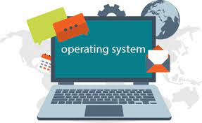
Universal TM
A modern computer is quite general and can run different algorithms (apps)
How about TMs? A TM which can run other TMs?
Universal TM.

Slide 3
Universal TM
A TM can also be represented by a (binary) string.
Thus a TM can also be used as an input/data to another TM.
This blurs the distinction between software, hardware and data.
Brings up the idea of a universal TM (first observed by Turing himself)

Slide 4

Universal TMs
There exists one universal TM that can simulate any other TM.

Slide 5
Universal TMs

Slide 6


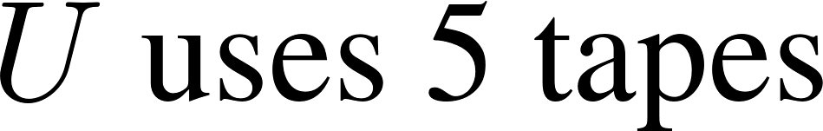

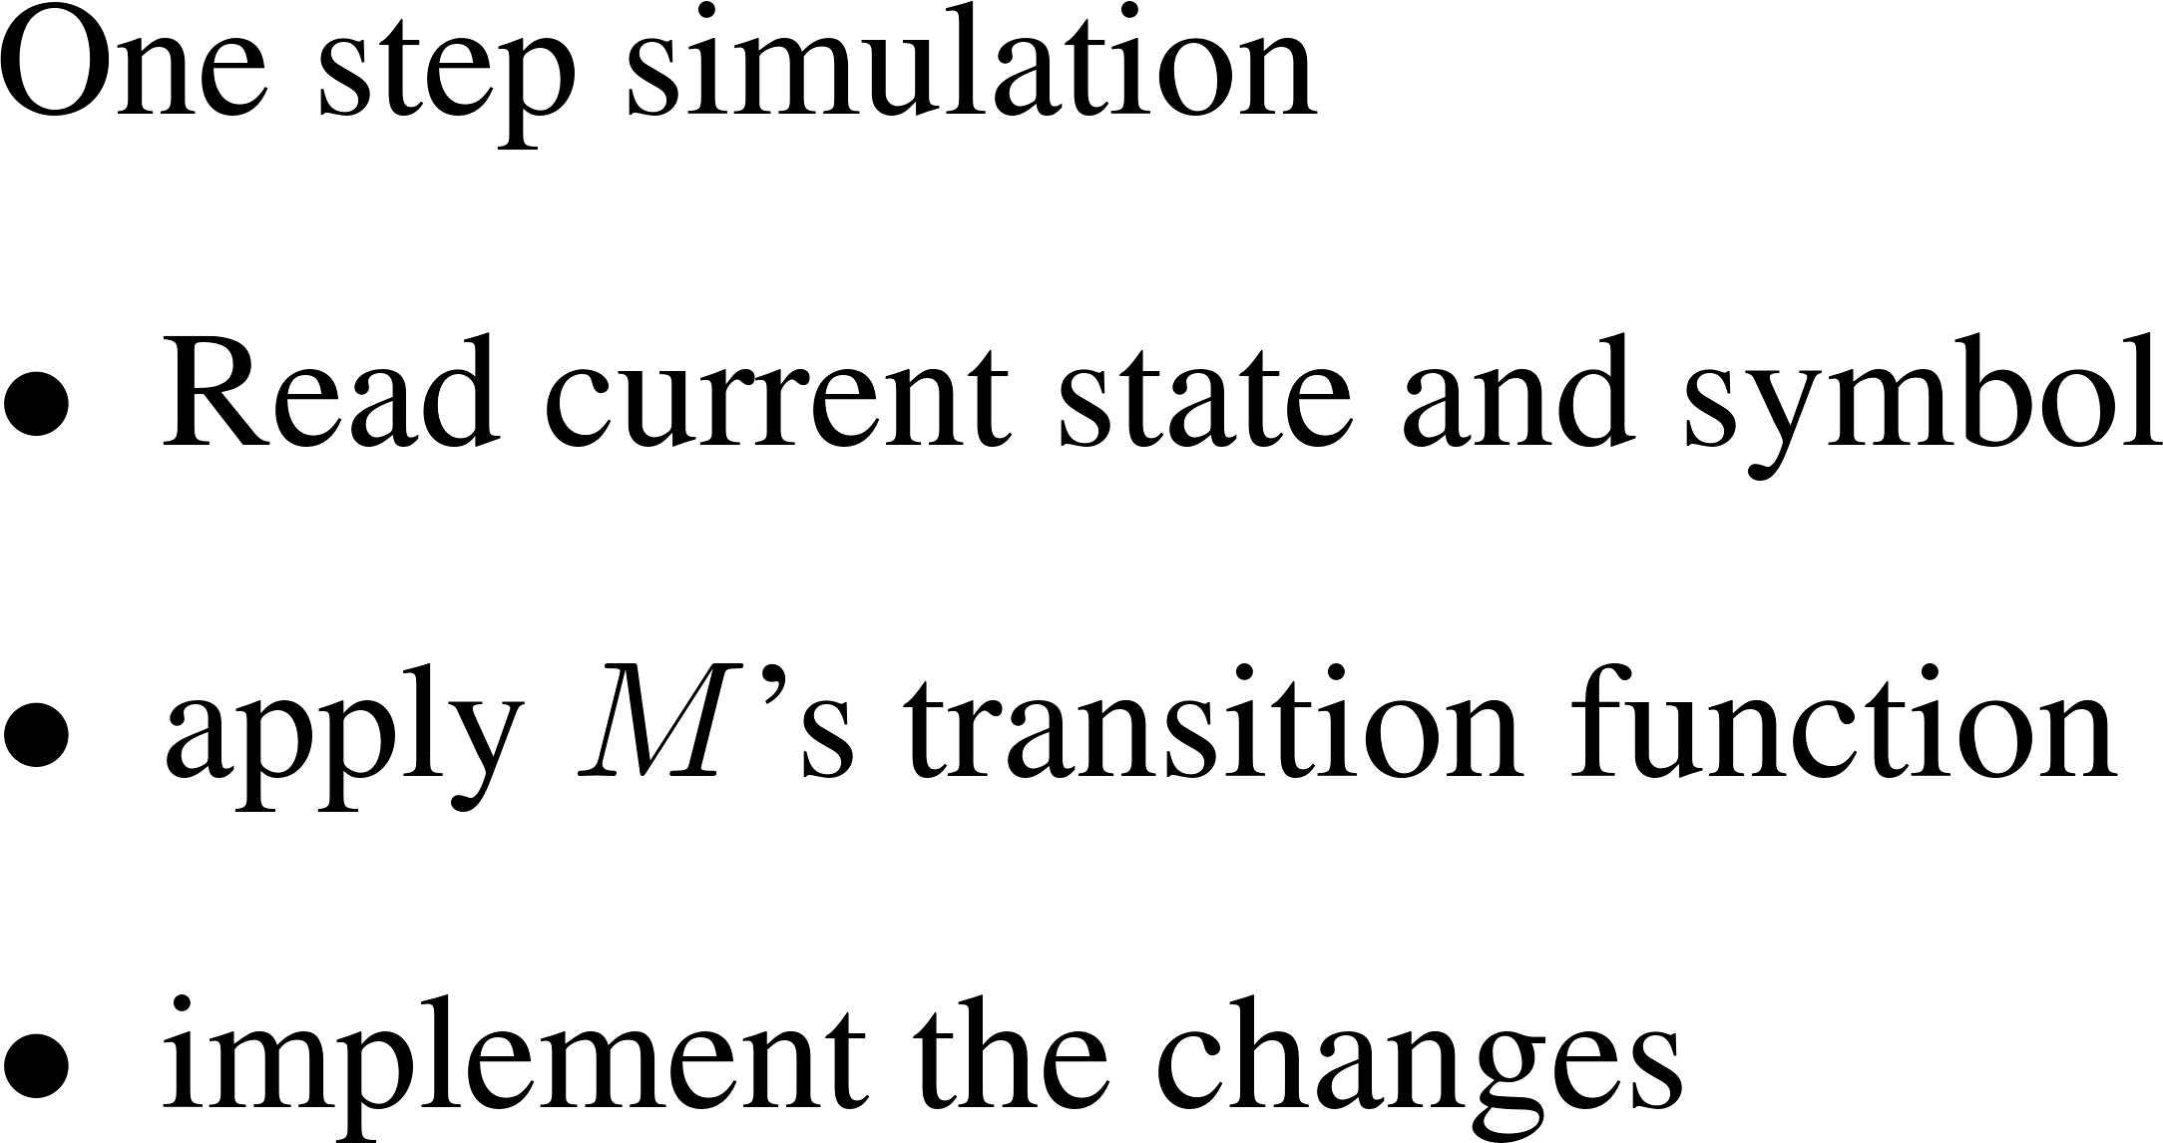

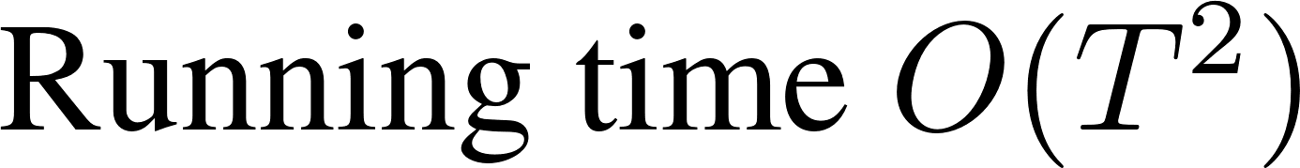
Universal TMs

Slide 7
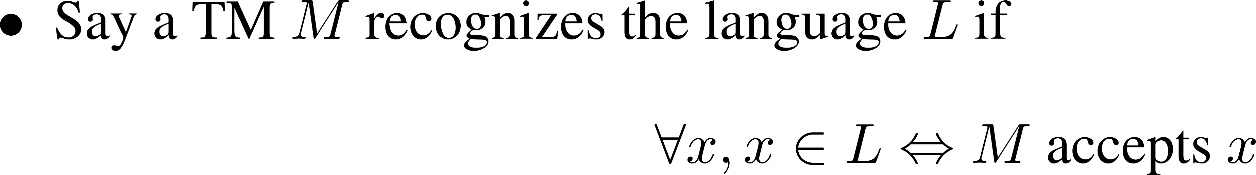
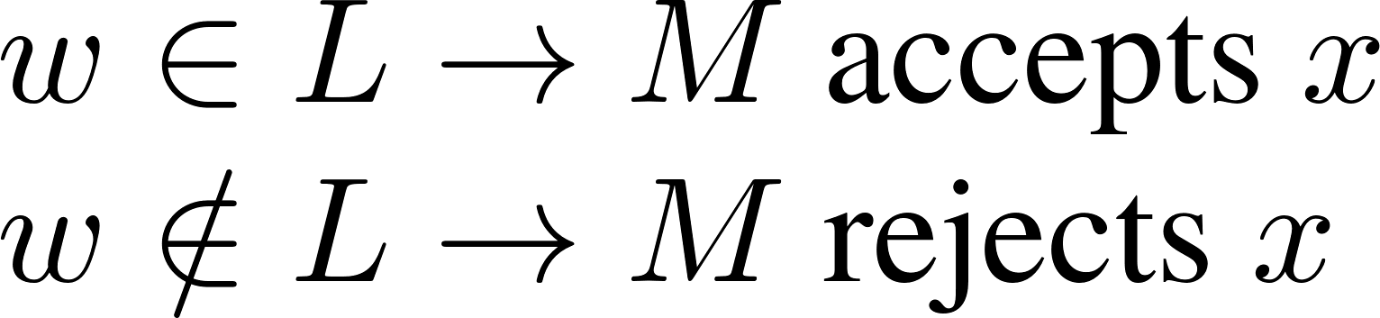
Recall: Recognize vs Decide

Slide 8


Recognize vs Decide
Decidable Language

Slide 9
Question
Are there Boolean functions that cannot be computed by any TM?
Are there languages that cannot be decided/recognized by any TM?
Are there languages that can be recognized but cannot be decided by any TM?

Slide 10
An Argument from Set Theory
Countable set vs uncountable set
Say a set S is countable if it is finite or there is a bijection between Natural numbers and S.
Otherwise, say S is uncountable

Slide 11


Examples

Slide 13


Questions
Is the set of all TMs countable?
Is the set of all (binary) languages countable?
Thm: There exists a language that cannot be decided/recognized by any TM

Slide 15
Topics
Computability
Reductions
Complexity

Slide 16
A specific example
Assumption: any binary string represents a TM (map invalid encoding to a trivial TM, e.g., one that rejects all inputs).
Define the Boolean function UC: {0,1}* →{0,1} as follows.

Slide 17

Claim
UC is uncomputable/the language is undecidable.

Slide 18
Another Example

Slide 19
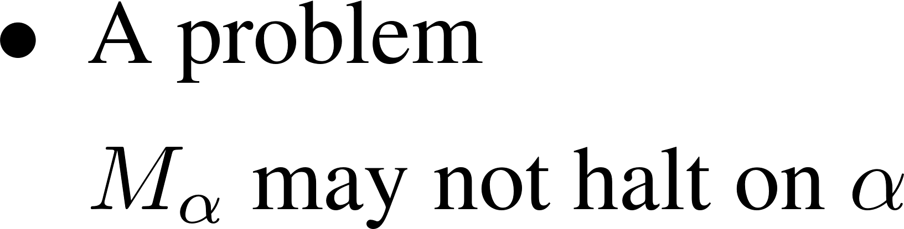
The construction

Slide 20
Another example

Slide 21
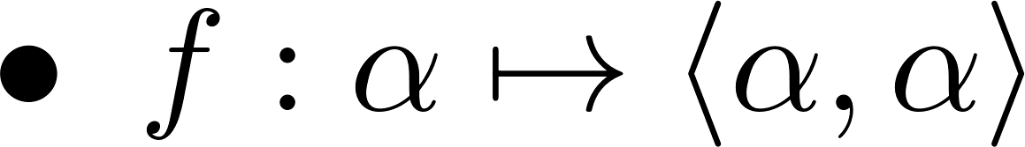
Analysis

Slide 22
Reduction
Intuitively, given two problems A and B, we reduce A to B so that to solve A, we can first solve B and use the solution to solve A.
Examples in real life
reduce calculation to building a calculator, reduce traveling to using buses, ships, airplanes …
Examples in mathematics:
reduce solving polynomial equations to finding the formula for the roots of the equations.

Slide 23




Mapping Reduction

Slide 24
Properties of mapping reduction
If A ≤m B then
If B is decidable, then A is also decidable.
If A is undecidable, then B is also undecidable.
To prove a language B is undecidable, find a known undecidable language A and show A ≤m B.

Slide 25
Example

Slide 27
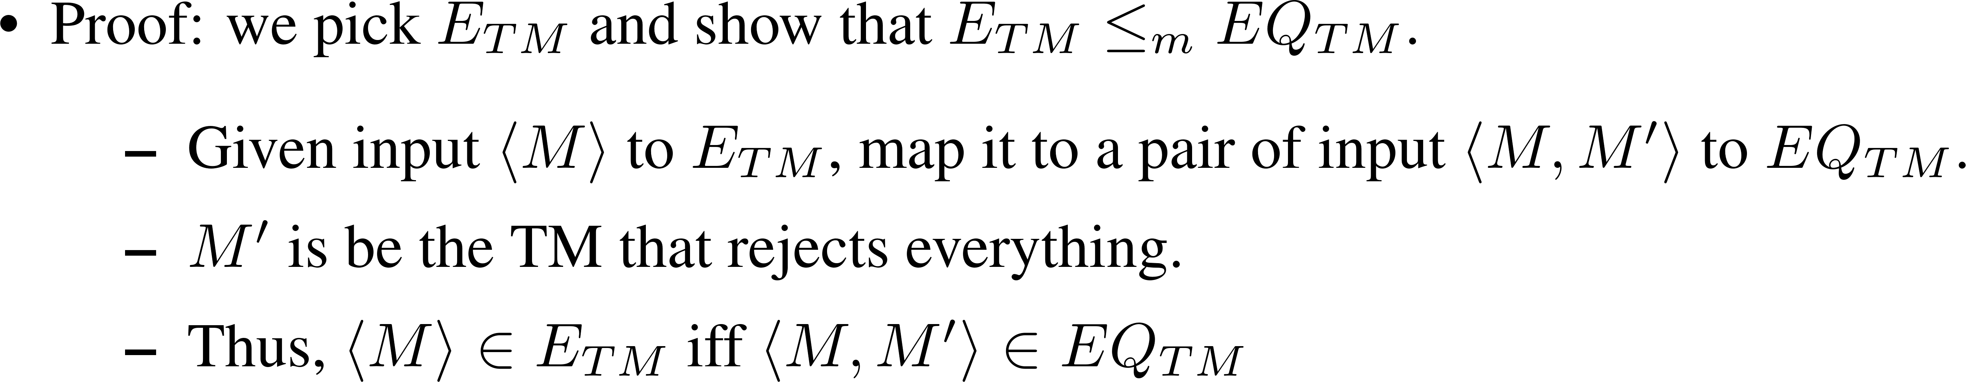
More Examples

Slide 28
More Examples
There are many other undecidable languages.
E.g., Hilbert’s 10th problem (posed at ICM 1900
Given a Diophantine Equation (a polynomial equation with integer coefficients and a finite number of variables), decide if it has an integer solution.

Slide 29
Looking Back
There are unrecognizable/undecidable languages
Recognizable but undecidable?
Decidable Language

Slide 31
Specific Examples of Unrecognizable Languages
Thm: A language A is decidable iff both A and its complement are recognizable.

Slide 32
Proof

Slide 33
Implication:
We know HALT and A_{TM} are undecidable but recognizable.
So their complements are unrecognizable.
Remark: the argument of diagonalization works as long as the machine can be represented as a finite string.
So there will always be unrecognizable/undecidable languages even if more powerful machines in the future.

